Slide 1

Identification of drug and protein-protein interaction among stress and depression:
A bioinformatics approach
Submitted By
Md. Abul Basar
ID: IT-17026
Session: 2016-17
Department of ICT, MBSTU
Supervised By
Bikash Kumar Paul
Assistant Professor
Department of ICT, MBSTU
ICT

Slide 2

Contents
Motivation
Problem Statement
Previous Work
Objectives
Conclusion

Slide 3

Motivation
Nowadays, people are suffering from different kinds of psychological disorders such as anxiety disorder, depression, bipolar disorder, panic disorder, stress, schizophrenia etc.
Approximately 4.4 % of the world's population suffers from depression, which affects 350 million people globally [1].
Women (5.1%) are more likely than males to suffer from depression (3.6%) [2].
Depression may lead to suicide at its worst , so it's important to diagnose and treat the disorder as early as possible.

Slide 4

Problem Statement
Stress is one of the most fatal disorders which affect huge number of people in worldwide
The American Stress Institute says that, in worldwide around 33% of persons report experiencing significant stress [3].
Depressed feelings were expressed by 51% of stressed individuals, while anxiety was recorded by 61% [4].
The injury caused of stress and depression is not examined significantly in any kind of research so far.

Slide 5
Previous Work
TITLE
Investigate common gene regulatory network pathway among bipolar disorder using R.
DESCRIPTION
Aimed to investigate the relationships between genetic variants in four diseases
Constructed a cross talking sub pathway via mapping inter-genes
Create a common pathway
PPI network
Create random network
Simulated in RStudio

Slide 6
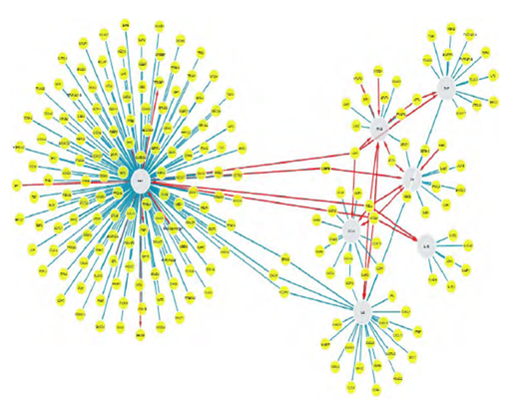
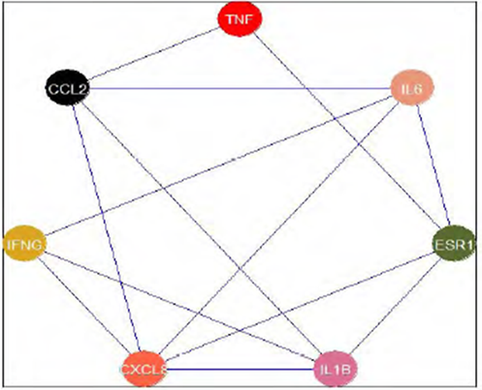
Previous Work
Figure 1: PPI Network with finally selected 7 common genes.
Figure 2: Random network using R.

Slide 7

Objectives
Finding a genetic relationship between stress and depression is the major objective of this study.
To establish a common pathway.
Analysis Topological Properties
To understand the PPI, GRN, PDI, TF-gene Interactions network .
To compare biochemical and genetic properties of these disease.
To develop a therapeutic novel drug.

Slide 8
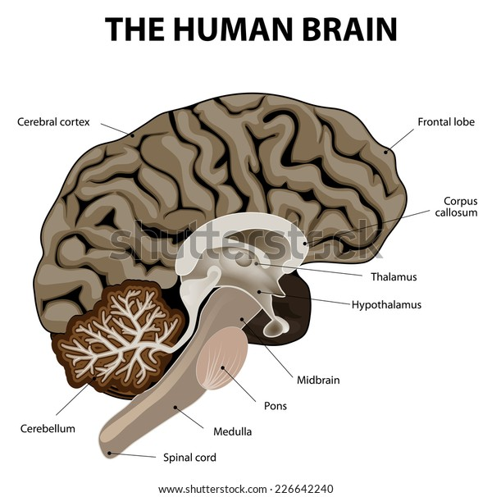



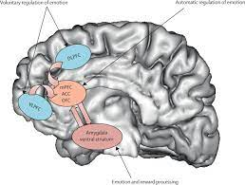
Conclusions
Stress
Collect Data
Filtered Data
Updateing...
Depression

Slide 9


Slide 10

References
World Health Organization, 2002. The world health report 2002: reducing risks, promoting healthy life. World Health Organization.
https://bmcpsychiatry.biomedcentral.com/articles/10.1186/1471-244X-14-85
https://www.therecoveryvillage.com/mental-health/stress/related/stress-statistics/#:~:text=According%20to%20The%20American%20Institute,that%20impacts%20their%20mental%20health
https://www.mentalhealth.org.uk/statistics/mental-health-statistics-stress#:~:text=Psychological%20effects,had%20suicidal%20thoughts%20and%20feelings.

Slide 11
value = True
while (value):
print("Thanks for your time and attention")

